Slide 1


SPORTS CLINIC APPOINTMENT SCHEDULER
TEAM TITANS
TEAM MEMBERS
NISARGA P- 22BI24EC402-T PRIYANKA BAI-22BI24EC403-T HEMA M-22BI24EC405-T MOUNIKA-22BI24EC408-T

Slide 2
INTRODUCTION ON SPORTS CLINIC APPOINTMENT SCHEDULER
Our innovative appointment scheduler ensures that patients can easily book their visits while providing clinics with the tools to manage their schedule effectively.

Slide 3


SPORTS APPOINTMENT SCHEDULER
This innovative tool allows athletes to easily book appointments for clinics, ensuring they receive the best care for their performance and injury management.

Slide 4
PROBLEM STATEMENT
Problem Statement: Sports Clinic Appointment Scheduler
Background
In a sports clinic, managing patient appointments efficiently is crucial for providing timely care. This program is designed to help clinic staff schedule, manage, and keep track of patient appointments.

Slide 5
OBJECTIVES
The goal/aim of sport’s clinic is to maintain, sustainable and at times to regain peak physical fitness i.e adaptability to stress… physical and mentaly
By scheduling appointments, clintes can secure their perferred times slots, guranteeing that they won’t miss out on these valuable offering
Appointments create structure and organization in a persons schedule.

Slide 6

MODULE SPLIT UP
Create: the program allows the user to create a appointment schedule for the patient
Update: if the information is entered ,the program updates the information of the appointment
Delete: the program includes the option to cancel the appointment
Display:the program displays the record of the patient

Slide 7
Result:

Slide 8
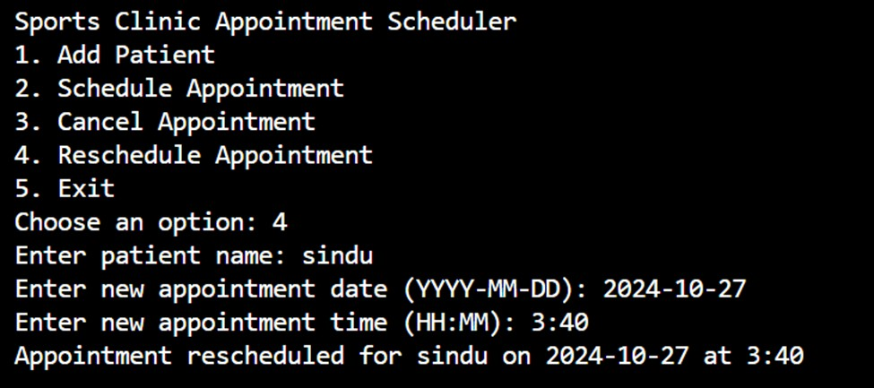

Slide 9
CONCLUSION
The provided code implements a straightforward appointment scheduling system for a sports clinic. It effectively manages patient information and appointments through object-oriented programming. Key functionalities include adding patients, scheduling, canceling, and rescheduling appointments.

Slide 10
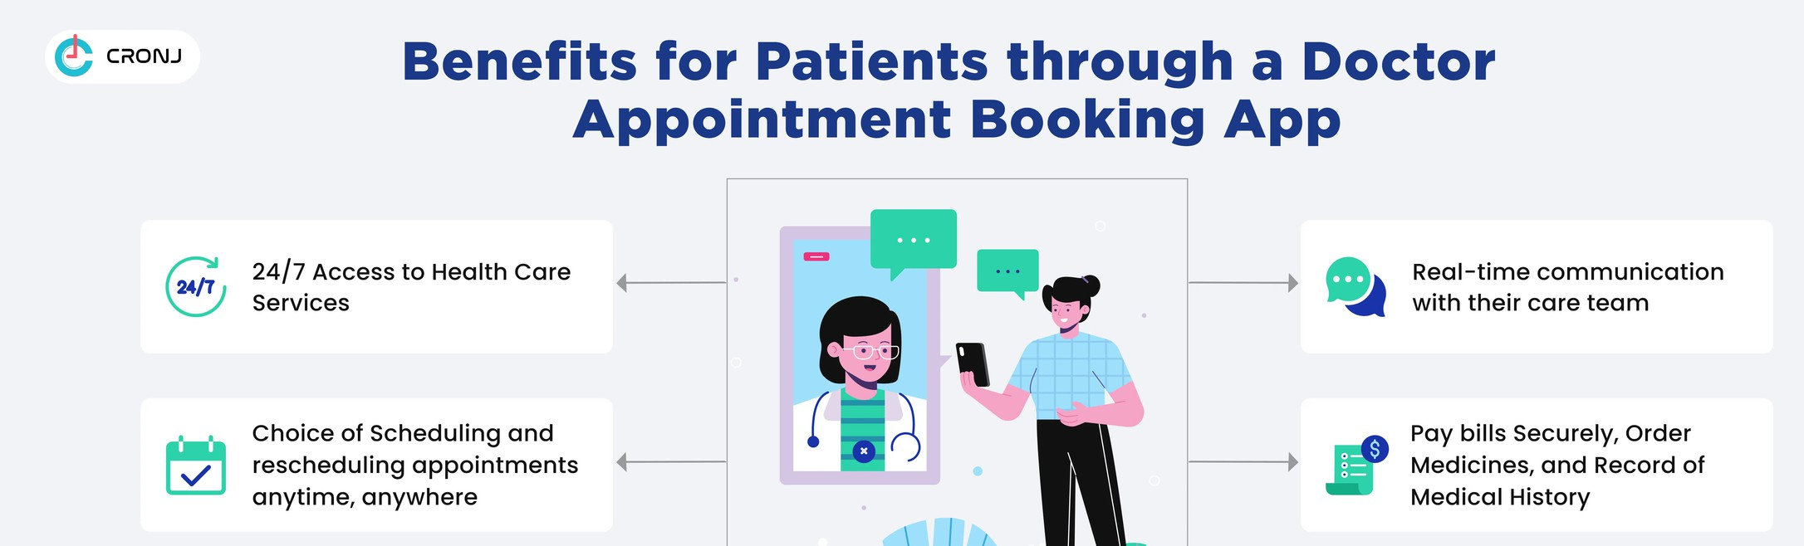
Future enhancement
DATA VALIDATION:-
Input validation Duplicate check
Appointment overlap checking Appointment management features
View appointments notification system
Patient History

Slide 11



